Slide 1

The Side Effects of Metformin
Metformin has become the first-line agent for the treatment of type 2 diabetes mellitus (T2DM)
Used in patients 10 years and over
Metformin has been used for hundreds of years, first in herb form then later approved for diabetes treatment
Is Metformin a Wonder Drug?
K
http://www.pharmaceutical-drug-manufacturers.com/pharmaceutical-dugs/metformin-hydrochloride.html

Slide 2
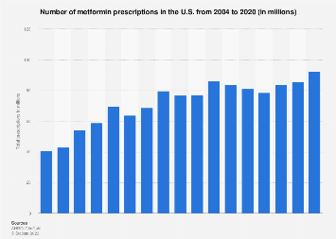
Number of metformin prescriptions in the U.S. from 2004 to 2020(in millions)
120
92.59
86.13
80
79.83
78.6
69.8
Total prescriptions in millions
40.89
40
0
2004
2008
2011
2014
2017
2020
K
https://www.statista.com/statistics/780332/metformin-hydrochloride-prescriptions-number-in-the-us/

Slide 3

The Negative Side Effects of Metformin
Mild:
Nausea, stomach pain and upset, and diarrhea
Heartburn and gas
Dizziness
Muscle aches
Fatigue
More serious:
Severe allergic reactions
Lactic Acidosis
Lowers B12
Drug interactions
Difficulty in breathing
Irregular heartbeat
K

Slide 4

socioeconomic Effects
Contributing Factors:
1. Income level
2. Education level
3. Occupation
4. Family and social support
5. Wealth
6. Access to good nutrition
Low socioeconomic factors can lead to adverse health effects
K
https://helpfulprofessor.com/socioeconomic-status-examples/
https://physicians.dukehealth.org/articles/socioeconomic-factors-play-significant-role-health-outcomes

Slide 5

Gender and metformin-associated adverse drug reactions
Gender differences in the number and severity of side effects were observed in the initial dosing of Metformin
Women had more side effects than men
Women were more likely to discontinue use of Metformin because of adverse side effects
Women may benefit from lower doses of the drug
Patients who quickly changed doses reported more side effects
RD
https://www.ncbi.nlm.nih.gov/pmc/articles/PMC7165141/#FPar1title

Slide 6
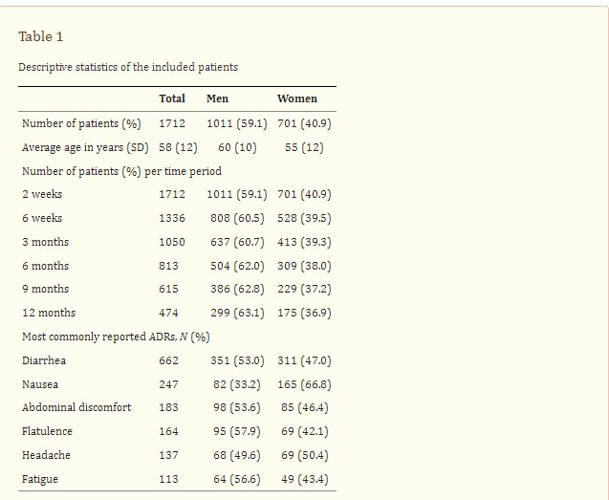
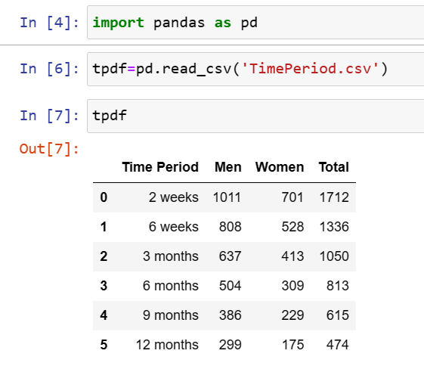
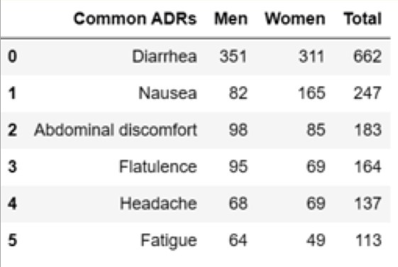
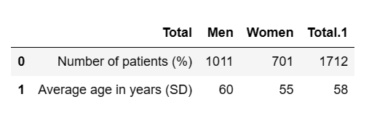
Tables of Metformin use for men and women over months and
Tables of the most common side effects separated by gender
Table 3
Table 2
Table 4
RD

Slide 7

Metformin vs other drugs
W

Slide 8
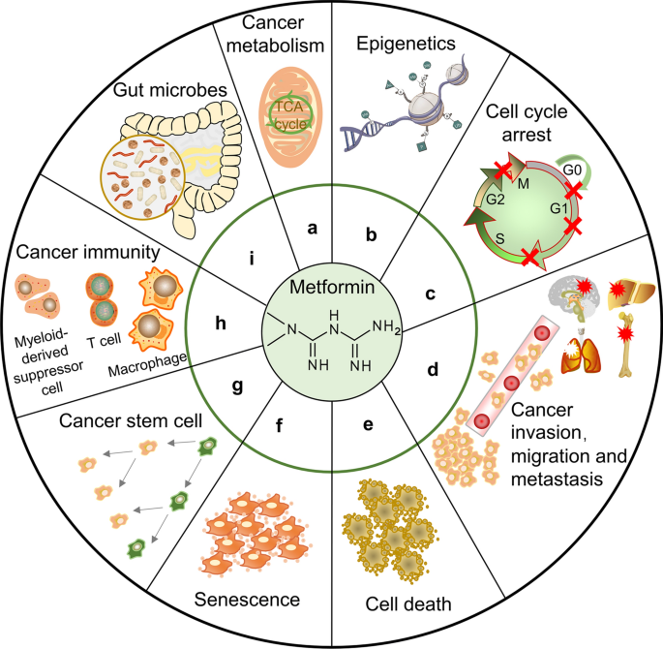
Metformin, Phenformin, and Mounjaro
Metformin improves the body’s response to insulin and effectively treats type 2 diabetes. Phenformin is a common drug used in some forms of metformin that treat type two diabetes.
Phenformin is known as a general Biguanides, meaning it is used to mostly lower the blood sugar levels of type two diabetics to keep their levels at a respected level.
Mounjaro is a common medication that includes phenformin in its creation. Prescribed for Diabetes type 2 patients.
Phenformin has now been withdrawn in most countries because of its association with severe and occasionally fatal lactic acidosis. It causes fatal conditions in 50% of its users in about 45 noted countries. Its most common fatal side effect includes cardiovascular problems, meaning 50% of its users report trouble breathing after extended use.
In some cases, the use of Phenformin in prescription drugs can lead to cases of Thyroid cancer, Acute kidney injury, Pancreatitis, Retinopathy, and Severe GI disease.
• There are similar drugs that include the drugs phenformin and have a similar effect on the body as Metformin. These drugs include Ethinyl estradiol (levonorgestrel), Mounjaro, and Ethinyl estradiol (Desogestrel).
• All these drugs are prescribed to both regulate insulin levels and sometimes used in Emergency Contraception cases. But all have side effects of raising a patient’s blood pressure, dizziness, and lactic acidosis, which can all be dangerous in some extreme cases, particularly older patients.

Slide 9
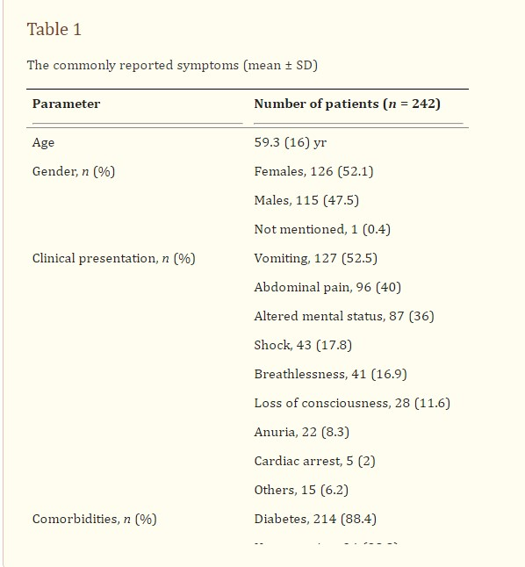
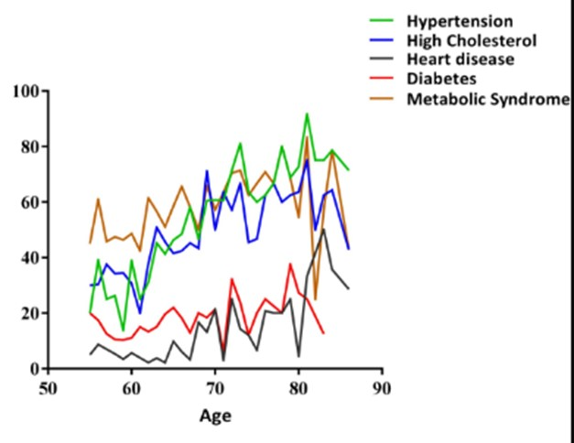
Metformin vs Phenformin
W
https://translational-medicine.biomedcentral.com/articles/10.1186/s12967-023-04263-8
https://www.nih.gov/news-events/news-releases/two-popular-diabetes-drugs-outperformed-others-large-clinical-trial

Slide 10


Slide 11
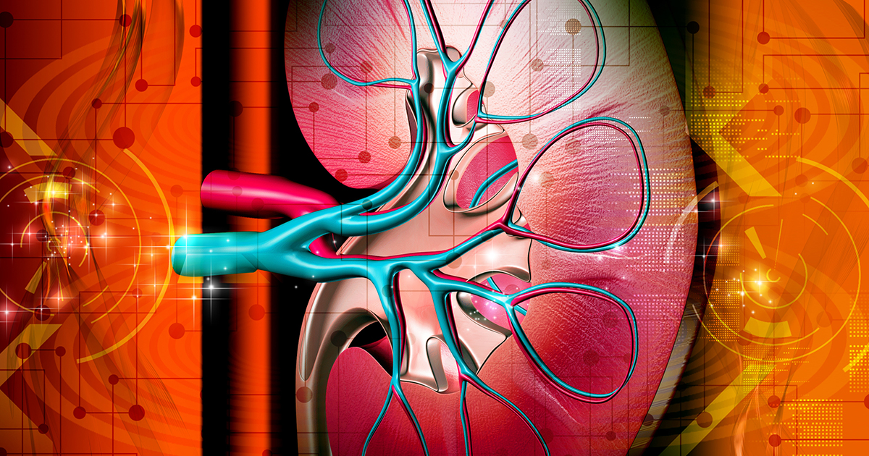
Metformin and Lactic Acid
Metformin, an antihyperglycemic, is widely used to treat type 2 diabetes mellitus (DM). A rare but important complication associated with this drug is the development of lactic acidosis:
Lactic Acidosis is a disease in which lactic acid accumulates in the blood and causes acidosis in the patient.
The criteria for diagnosis are a lactate level of >2 mmol/L in the blood and a blood pH of <7.2.
The study aims to assess the risk of acidosis in diabetic advanced chronic kidney disease (CKD) patients on and off metformin.
Chronic kidney disease (CKD) means your kidneys are damaged and can’t filter blood the way they should
Ra
https://www.niddk.nih.gov/health-information/kidney-disease/chronic-kidney-disease-ckd

Slide 12
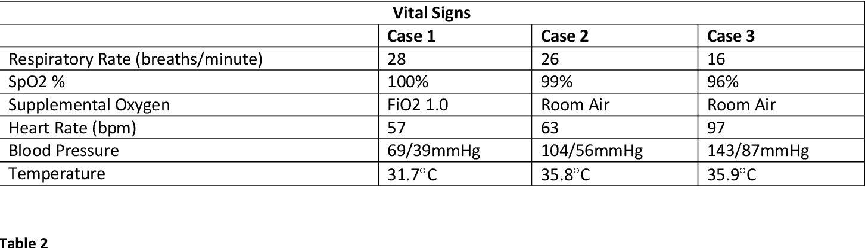
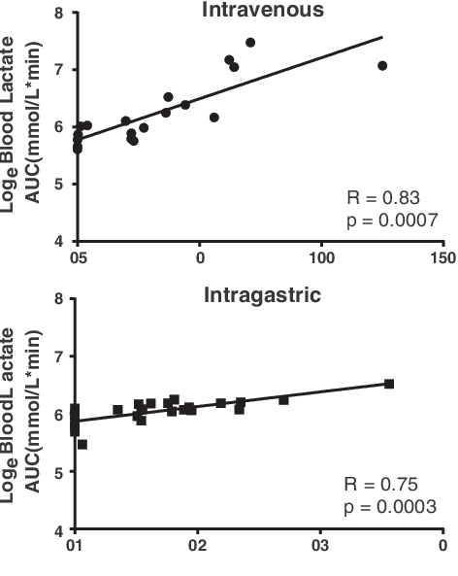
Laboratory-confirmed Metformin-Associated Lactic Acidosis
This study showed an increase in Lactic Acid over days of use of metformin given orally and intravenously.
And the adverse effects on vital signs
Impaired kidney function: Metformin is primarily excreted by the kidneys, so individuals with kidney impairment are at higher risk of lactic acidosis.
Liver dysfunction: Liver dysfunction can interfere with lactate metabolism, increasing the likelihood of lactic acidosis.
Congestive heart failure can reduce tissue perfusion and oxygenation, contributing to lactic acidosis.
Symptoms: Lactic acidosis can present with non-specific symptoms, making diagnosis challenging. Common symptoms include nausea, vomiting, abdominal pain, weakness, rapid breathing, and an elevated heart rate. You must seek immediate medical attention if you experience these symptoms while taking metformin.
Ra
https://www.semanticscholar.org/paper/Metformin-associated-lactic-acidosis%3A-Current-on-DeFronzo-Fleming/5f4071a19ce661e7eb7665de752f246ebf652aef/figure/1

Slide 13
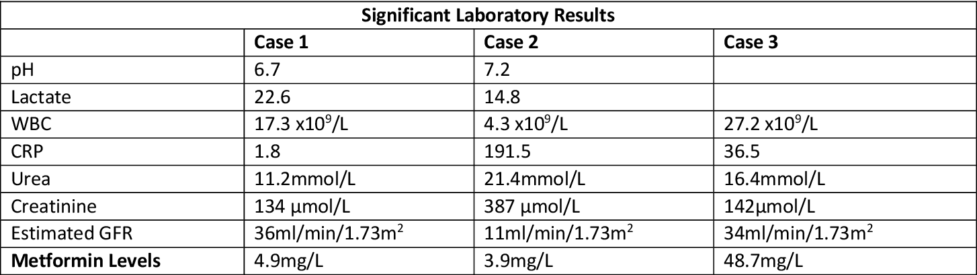
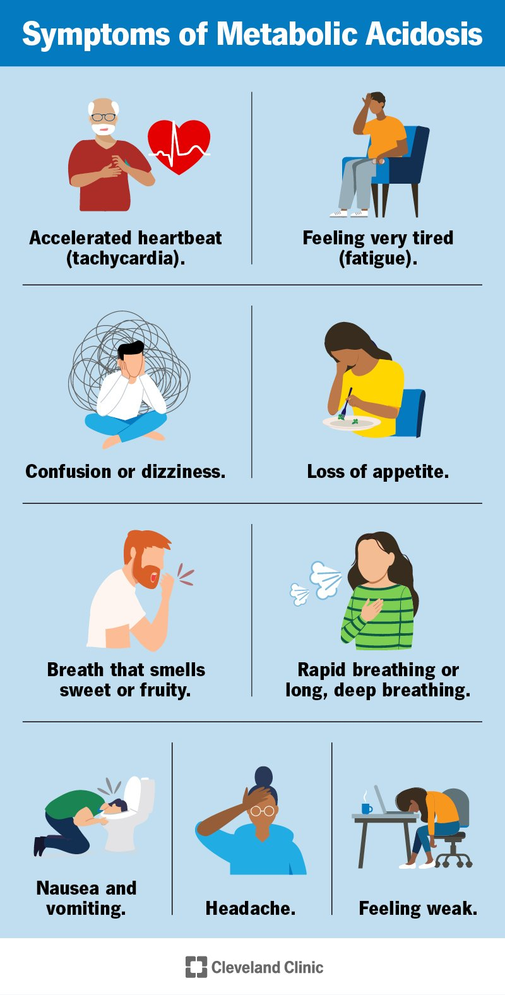
Lactic Acidosis
**This study showed that levels of lactic acid reduced as the dosage of metformin was reduced
A buildup of lactic acid in the bloodstream, especially in people with kidney disease, can cause serious side effects
Metformin prescriptions must be limited in these patients
Ra
https://www.semanticscholar.org/paper/Laboratory-Confirmed-Metformin-Associated-Lactic-Nestor-Nasim/cfb3e22e7d42cbe68c3c0035f9fb93d792093341

Slide 14
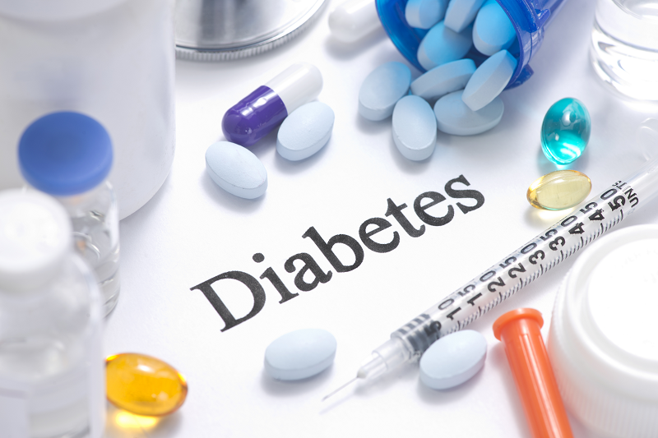
B12 deficiency
T
https://vitaminsforyou.co.za/metformin-glucophage-vitamin-b12-deficiency/

Slide 15

Metformin has been shown to lower b12 levels in patients
Several observational studies showed that long term use of metformin leasds to significantly lower vitamin B12 levels
Table 1. Vitamin B12 deficiency according to sex and age.
Low B12 level | Borderline B12 level
Total population | 7.4% (95% CI: 7–12%) | 20.9% (95% CI: 15–27%)
Men | 12% (95% CI: 6–21%) | 23% (95% CI: 15–34%)
Women | 4% (95% CI: 1–10%) | 18% (95% CI: 12–28%)
Less than 70 years | 5% (95% CI: 2–10%) | 20% (95% CI: 14–29%)
More than 70 years | 12% (95% CI: 5–22%) | 22% (95% CI: 13–34%)
Patients older than 70 years (n = 58), borderline levels of vitamin B12 were found in 13 patients (22%; 95% CI: 13–34%) and low levels were found in seven patients (12%; 95% CI: 5–22%). However, the coefficient of correlation between age and vitamin B12 levels was not statistically significant (coefficient: −0.86; 95% CI: −2.7, 1.0)
A clinical trial consisting of 162 patients, 72 men, and 90 women, with an average age of 64, and use of 1536 mg metformin daily over a 5-year period significantly lowered vitamin B12. (Table 1). Researchers have concluded comparable results across different age groups and ethnicities. However, the exact mechanisms causing vitamin B12 deficiency are not established.
T

Slide 16
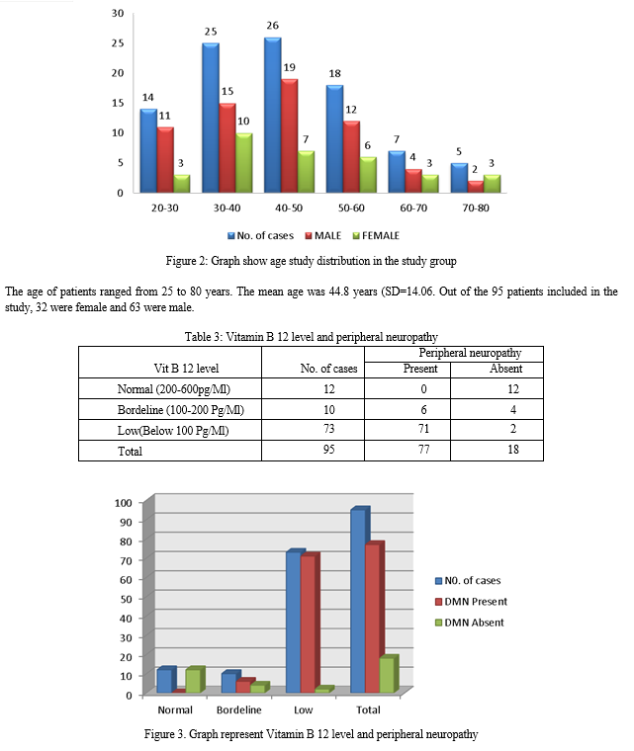

Low levels of B12 can cause peripheral neuropathy
Low levels of B12 damage the protective tissue around nerves, and they fail to function correctly.
Table 3. Table showing the relation between vitamin B12 deficiency and peripheral neuropathy
Several observational studies showed that long-term use of metformin leads to significantly lower vitamin B12 levels.
There was a 17.8% to 26.8% reduction of B12 in cross-sectional studies and 6.3% to 18.7% in clinical studies.
T

Slide 17
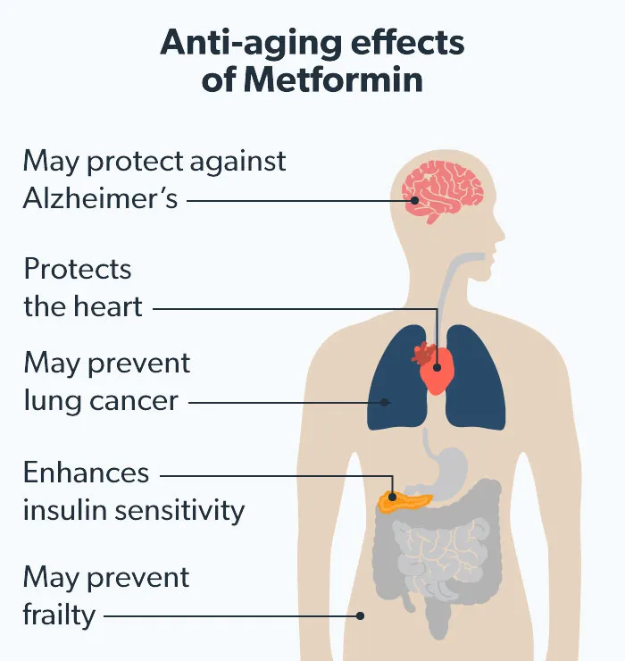
Positive side effects of metformin
Metformin has also been shown to have positive effects in some patients.
For patients that can tolerate the negative side effects – metformin has been shown to have:
Cardiovascular benefits
Weight loss in diabetics
Delay or prevent diabetes in prediabetics
Control blood sugar during pregnancy
Aids in menstrual regulation in women with Polycystic Ovary Syndrome (PCOS)
Lesson weight gain in patients taking psychiatric drugs
Effects Under Study
Lower cancer risks
Lesson cognitive decline
Lower stroke rate
Slow aging and increase life expectancy
K
https://ro.co/health-guide/metformin-anti-aging/

Slide 18

Cardiovascular disease lowered by Metformin
In 2019, there were 18.56 million world deaths from cardiovascular diseases and 1.55 million deaths from Diabetes.
In the age range of 15–49-year-olds, there were 1.24 million world deaths from cardiovascular disease and 120,735 from diabetes.
In the age range of 50-69-year-olds, there were 5.11 million world deaths from cardiovascular disease and 581,447 from diabetes
Modern studies of adults over the age of 70 show death rates even higher for both diseases
K
https://ourworldindata.org/causes-of-death#breakdown-of-deaths-by-age
https://ourworldindata.org/causes-of-death

Slide 19
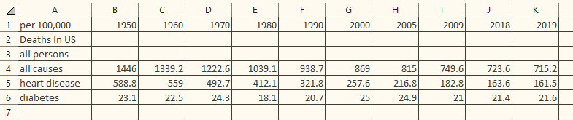
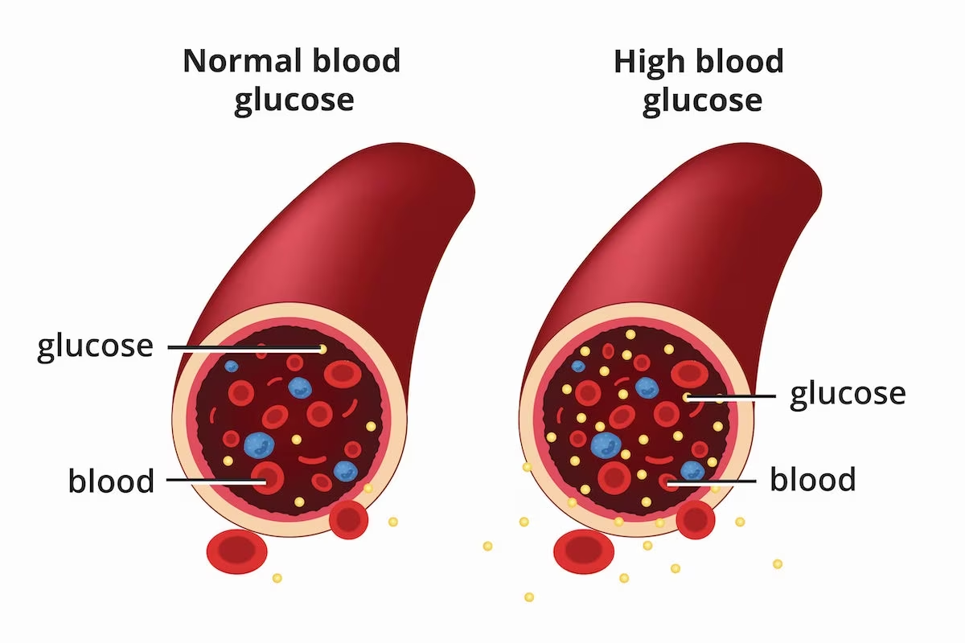
Table showing Cardiovascular and diabetes information for different groups over time
Data is from 1950 to 2019
The data showed that cardiovascular disease was the number one cause of deaths every year studied
The data also showed that diabetes also caused a significant number of deaths
High insulin rates are a risk factor for both diseases
Metformin has been shown to reduce blood insulin levels significantly
In more detailed studies, the data indicated that black females had the highest percentage of deaths caused by cardiovascular disease and diabetes
Socioeconomic studies have shown that this group has the highest mortality
Because women, especially black women, were not taken seriously by medical professionals when they were having heart attacks
They were also less likely to be treated for diabetes
They would not have access to drugs like Metformin
K

Slide 20

Summary
Is Metformin a Wonder Drug?
Metformin in the right dosages can help many people to lower acute and chronic health conditions
High blood sugar causes many preventable chronic diseases
Unfortunately, more than 25% of patients develop serious side effects and are forced to stop treatment
If more people had access to proper medical care and drugs like Metformin – death rates for many illnesses could be reduced
K

Slide 21
References
Federal Drug Administration (FDA). (2017). FDA Drug Safety Communication: FDA revises warnings regarding use of the diabetes medicine metformin in certain patients with reduced. (Safety Announcement). kidhttps://www.fda.gov/drugs/drug-safety-and-availability/fda-drug-safety-communication-fda-revises-warnings-regarding-use-diabetes-medicine-metformin-certain#:~:text=Data%20Summary,mild%20to%20moderate%20renal%20impairment.ney function.
Shmerling, R.H. (2021). Is metformin a wonderdrug? https://www.health.harvard.edu/blog/is-metformin-a-wonder-drug-202109222605#:~:text=Medicines%20containing%20guanidine%2C%20such%20as,by%20the%20discovery%20of%20insulin.
Kao HW, Tsai KW, Lin Wc. Synergistic Effect of Metformin and Lansoprazole Against Gastric Cancer through Growth Inhibition. Int J Med Sci 2023; 20(6):717-724. doi:10.7150/ijms.82407. https://www.medsci.org/v20p0717.htm
de Vries, S. T., Denig, P., Ekhart, C., Mol, P. G. M., & van Puijenbroek, E. P. (2020). Sex Differences in Adverse Drug Reactions of Metformin: A Longitudinal Survey Study. Drug safety, 43(5), 489–495. https://doi.org/10.1007/s40264-020-00913-8

Slide 22
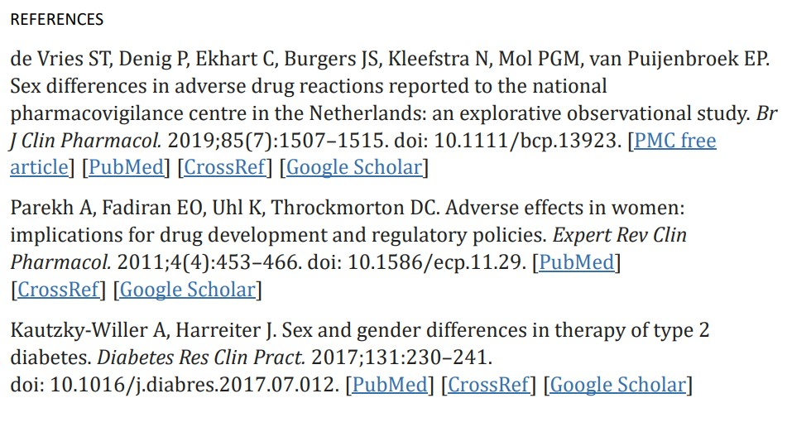

Slide 23
References
1.Khan, A. (n.d.). Prevalence of Vitamin B12 Deficiency in Patients with Type II Diabetes Mellitus on Metformin: A Study from Khyber Pakhtunkhwa. National Library of Medicine. https://www.ncbi.nlm.nih.gov/pmc/articles/PMC5647126/ accessed 07/25/2023
Alvarez, M., Sierra, O. R., Saavedra, G., &amp; Moreno, S. (2019, October 1). Vitamin B12 deficiency and diabetic neuropathy in patients taking metformin: A cross-sectional study. Endocrine connections. https://www.ncbi.nlm.nih.gov/pmc/articles/PMC6790897/#:~:text=of%20vitamin%20B12.-,Higher%20doses%20of%20metformin%20and%20male%20sex%20were%20factors%20related,in%20patients%20with%20diabetic%20neuropathy.
Ahmed, M. (2016). Metformin and Vitamin B12 Deficiency: Where Do We Stand? Department of Pharmacology, Faculty of Health Sciences, University of Pretoria, Pretoria, South Africa. https://journals.library.ualberta.ca/jpps/index.php/JPPS/article/view/27581/20867

Slide 24
References
Corrigendum to “Metformin-associated lactic acidosis: Current perspectives on causes and risk” [Metabolism 65 (2016) 20–29] Ralph DeFronzo a , G. Alexander Flemingb , Kim Chenc , Thomas A. Bicsakc,⁎
https://www.metabolismjournal.com/article/S0026-0495(15)00306-6/fulltext
D-Lactic Acid as a Metabolite: Toxicology, Diagnosis, and Detection
M. PohankaChemistry, Medicine
BioMed research international
2020
Rena G, Hardie DG, Pearson ER: The mechanisms of action of metformin. Diabetologia. 2017, 60:1577-1585. 10.1007/s00125-017-4342-z
Corcoran C, Jacobs TF: Metformin. StatPearls Publishing, Treasure Island, FL; 2022.
Crowley MJ, Diamantidis CJ, McDuffie JR, et al.: Metformin Use in Patients with Historical Contraindications or Precautions: Evidence-based Synthesis Program. Department of Veterans Affairs (US), Washington, DC; 2016.

